Slide 1
Capstone Project - The Battle of the Neighborhoods
The analysis of the best neighborhoods New York City using data science methodologies.

Slide 2
Introduction
Background
People have their own personal preferences of what they want around their house to live comfortably. When people are moving into a new neighborhood, it becomes difficult to find the best neighborhood that match their needs. Data analysis and machine learning helps solve this problem.
Problem
Customer A is planning to move to New York City. They have a personal preference of what needs to be close to their home for e.g. – Hospital, Restaurant, etc. They need help finding a neighborhood to move to in New York City with proximity to their needs and preferences.
The objective of this project is to use Machine learning algorithms and Foursquare location to determine the best neighborhood based on Customer A’s needs and preferences in New York City.

Slide 3
Target Audience
Anyone planning to move to a new neighborhood
Real estate agents to help find a new place for their customers.
This report is targeted to Customer A’s preference. But this can be tailored to any person’s needs.

Slide 4
Data
The datasets used for analysis for this project are:
New York City data
Data Source: https://cocl.us/new_york_dataset
Description: This data set contains Borough, Neighborhoods with latitudes and longitudes. This is used to explore different neighborhoods in New York city.
Foursquare API
Data Source: https://api.foursquare.com
Description: This API we will get all the venues in the New York city neighborhood. We can then analyses which neighborhood has the greatest number of venues that match Customer A’s preference.

Slide 5

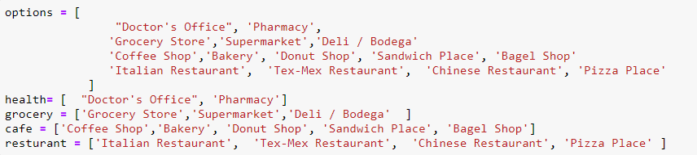
Customer Preference
A list of favorite categories is created - Options. For our project Customer A’s preference is as shown.
Each of the other categories are buckets to a main category; For e.g. "Doctor's Office", 'Pharmacy' is labeled as Health.

Slide 6
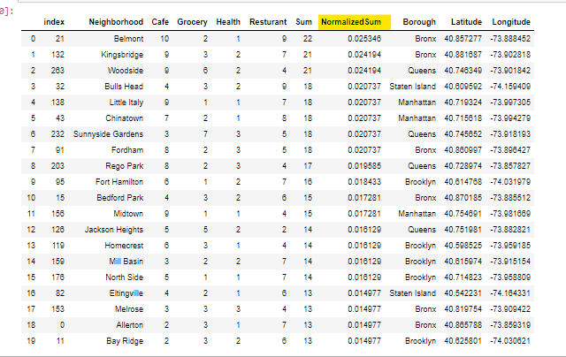
Normalized Score
A Normalized score is calculated for each Neighborhood based on the count of favorite main categories in the Neighborhood
Normalized Score/Sum = Count of categories in Neighborhood/Total count of categories

Slide 7
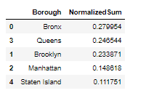
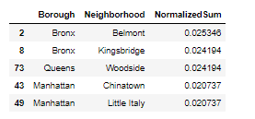
Normalized Sum
Top Boroughs are calculated based on the Normalized Score/Sum for the neighborhoods
Top Boroughs are calculated based on the Normalized Score/Sum for the neighborhoods

Slide 8
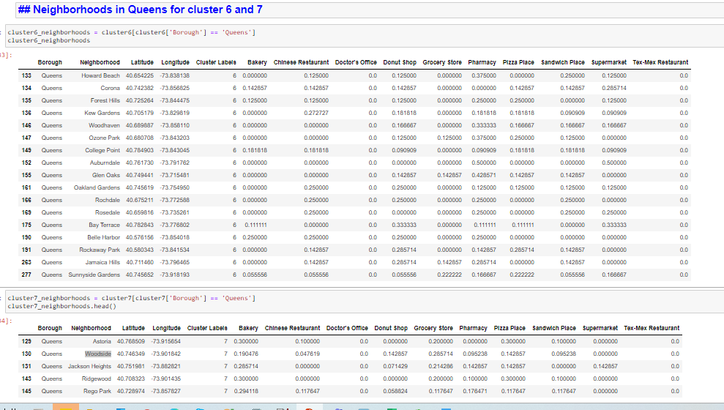
Clustering
The k-means clustering is used to cluster the neighborhood into 8 clusters.
In this analysis only favorite venues are considered -this was done by using one hot encoding, then calculated the mean of each venue in each neighborhood and finally grouped the data frame based on the neighborhood.
The distribution of the clusters is shown in figure
On further analysis the clusters 6 and 7 look most promising based on customer preference.
The recommendation would be to move tQueens based on clustering and Normalized sum.

Slide 9
Results and Discussion
For this report both normalized sum and clustering was performed.
Considering normalized sum analysis, it was found that either Bronx or Queens could be a good choice to move.
The k-means provided an insight into similar neighborhoods and narrowed it down to cluster 6 and 7.
After combining these results, we identified one single borough, that is most likely the best choice: is Queens.
Upon further investigation the neighborhood Woodside in Queens borough seems a good option based on both normalized sum and clustering

Slide 10
Conclusion
The purpose of this analysis was to identify a borough/neighborhood based on all the categories in the customer (i.e. arks, coffee, bars, restaurants, grocery stores).
For this report both normalized sum and clustering was performed.
After combining these results, we identified one single borough, that is most likely the best choice: is Queens – Woodside.
Upon further investigation the neighborhood Woodside in Queens borough seems a good option based on both normalized sum and clustering

